Slide 1
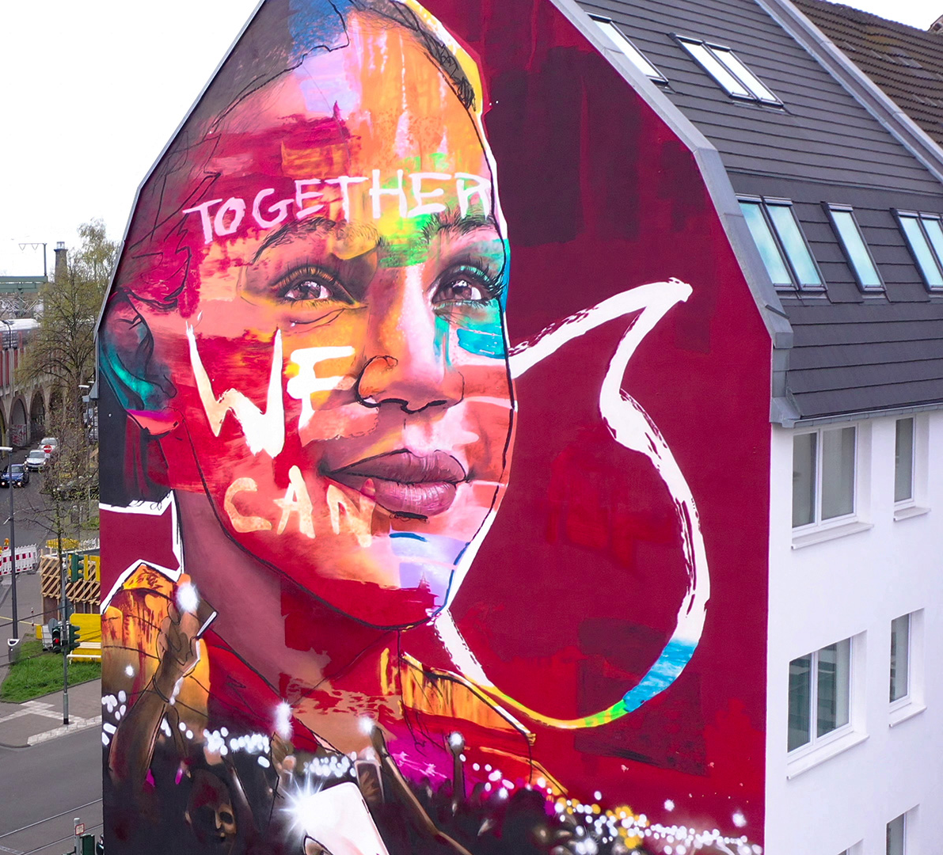
#TogetherWeCanRebuild
Young Lions – TURKIYE
İpek Balcı & Mert Mustafa Ünsal

Slide 2
Challenges
Poor Infrastructure
+3,5 Million
School-aged children are affected from earthquake
Lack of schools, classrooms, teachers, internet connection
Mental Problems
Feeling alone & devastated, left-behind

Slide 3
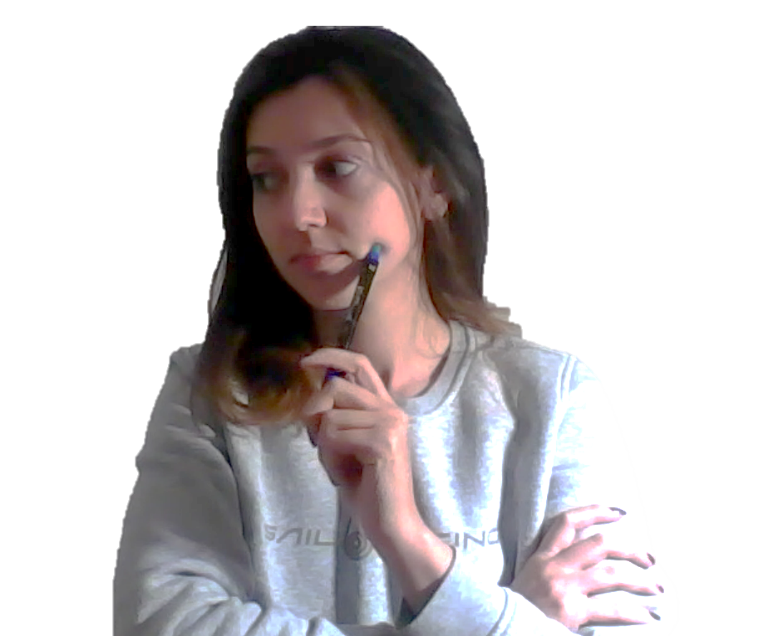
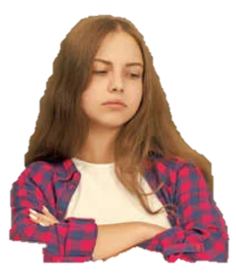
Target Audiences & Key Insights
Teachers and competent students (İpek, 25)
I feel lost & left behind
There is no one to help my courses.
There is no special curriculum & little organization
(10-17 y.o.) Students affected from earthquake (Şeyma , 15)
I feel useless & guilty because I’m safe at home.
I wish I can do more about earthquake-zone.
I am eager to help and I want to make an impact.

Slide 4
How can Vodafone make the greatest impact?
Vodafone Yanımda
16 M+ MAU
AI Based Digital Assistant
TOBi
«Coding Tomorrow»
10+ years of experience
300K+ children

Slide 5
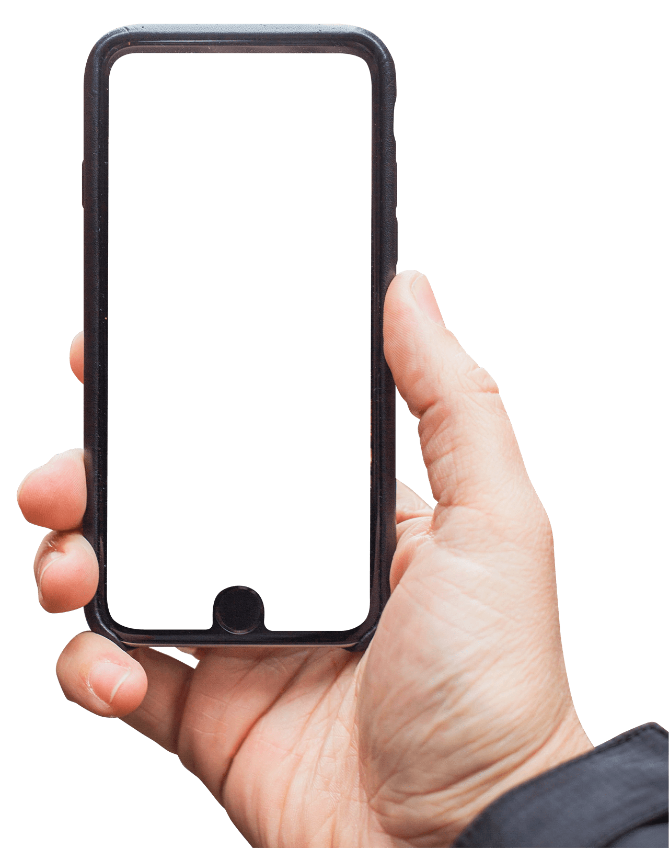
#TOGETHERWECANREBUILD
Please Select Your Role
Welcome to
#TogetherWeCanRebuild!
Meet your online study buddy with TOBi Chatbot
I need assistance
I’m here to help
Objective: Create a credible & sustainable platform to match earthquake students with educational volunteers while eliminating physical barriers.
See Details
Terms of Use
Please expect a return in maximum 24 hours.
Notes:
-

Slide 6
How it Works
S
Smart Matching
Built-in Video Chat
Rating
AI Based Best Match for Both Parties
No Need for Another App
Rate Your Buddy’s Attributes for Better Match

Slide 7
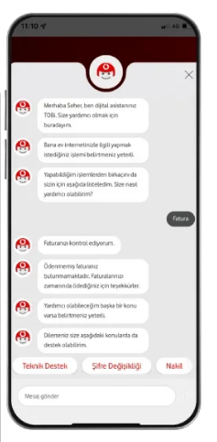
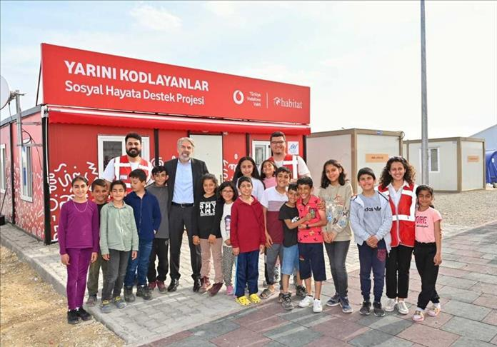
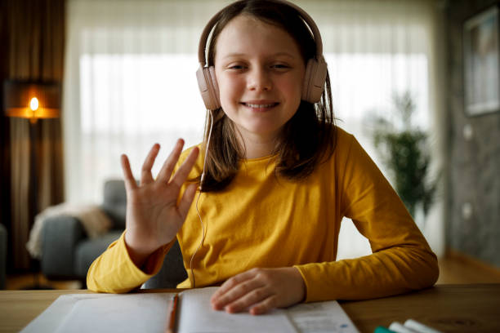
Access From Anywhere with Vodafone Yanımda
Soru
Book Time Slots from Vodafone Containers for children in earthquake zone
TOGETHER WE CAN REBUILD
I can navigate you to below choices if you want.
Report
Call Moderator
Send Message

Slide 8
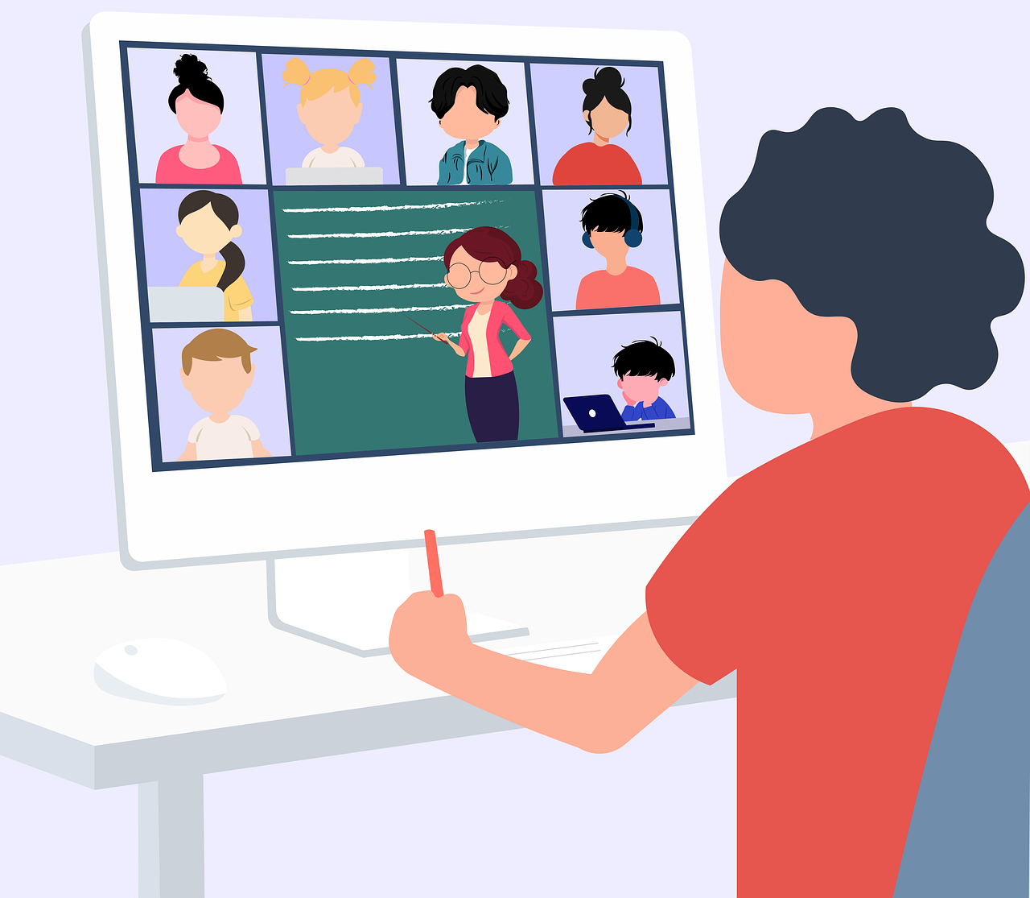
Urges all stakeholders to step-in & take action
We expect a 360° campaign that…
Motivates people to be a direct/indirect member of this community

Slide 9
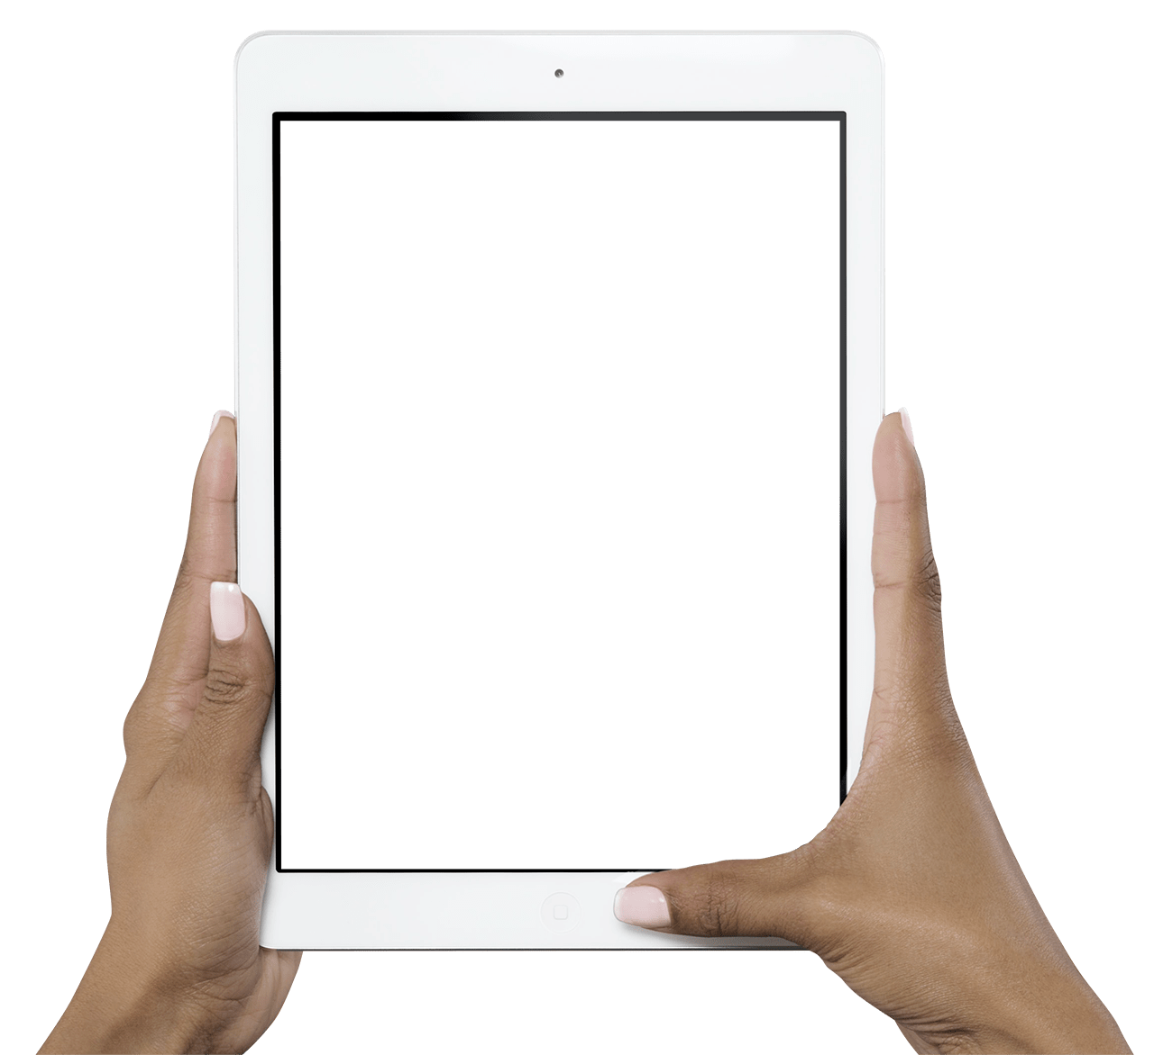
Timeplan
Budget
Production (including all software development & offline designs)
Media Spending (TV, Digital, PR, Influencer Marketing)
KPIs
20M Total Reach
5M Organic share on SM
500K+ App Download
300K+ Total study session
1 M TL
3 M TL
28/04
12/5
20/05
01/06
15/06
01/07
Brief
Debrief
Final KV
Creative Idea & Concept
Final ATL
Launch

Slide 10
THANK YOU!
İpek Balcı
Mert Mustafa Ünsal
Vodafone Turkiye

