Slide 1
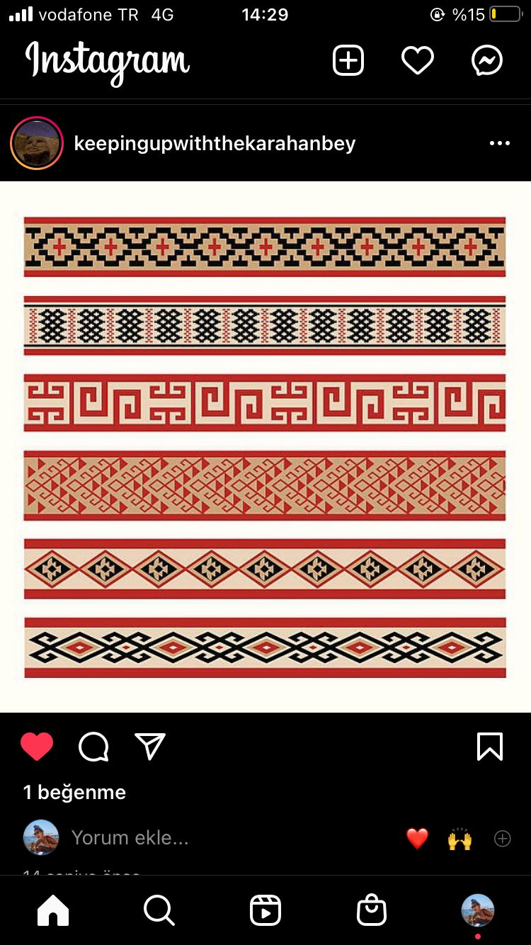
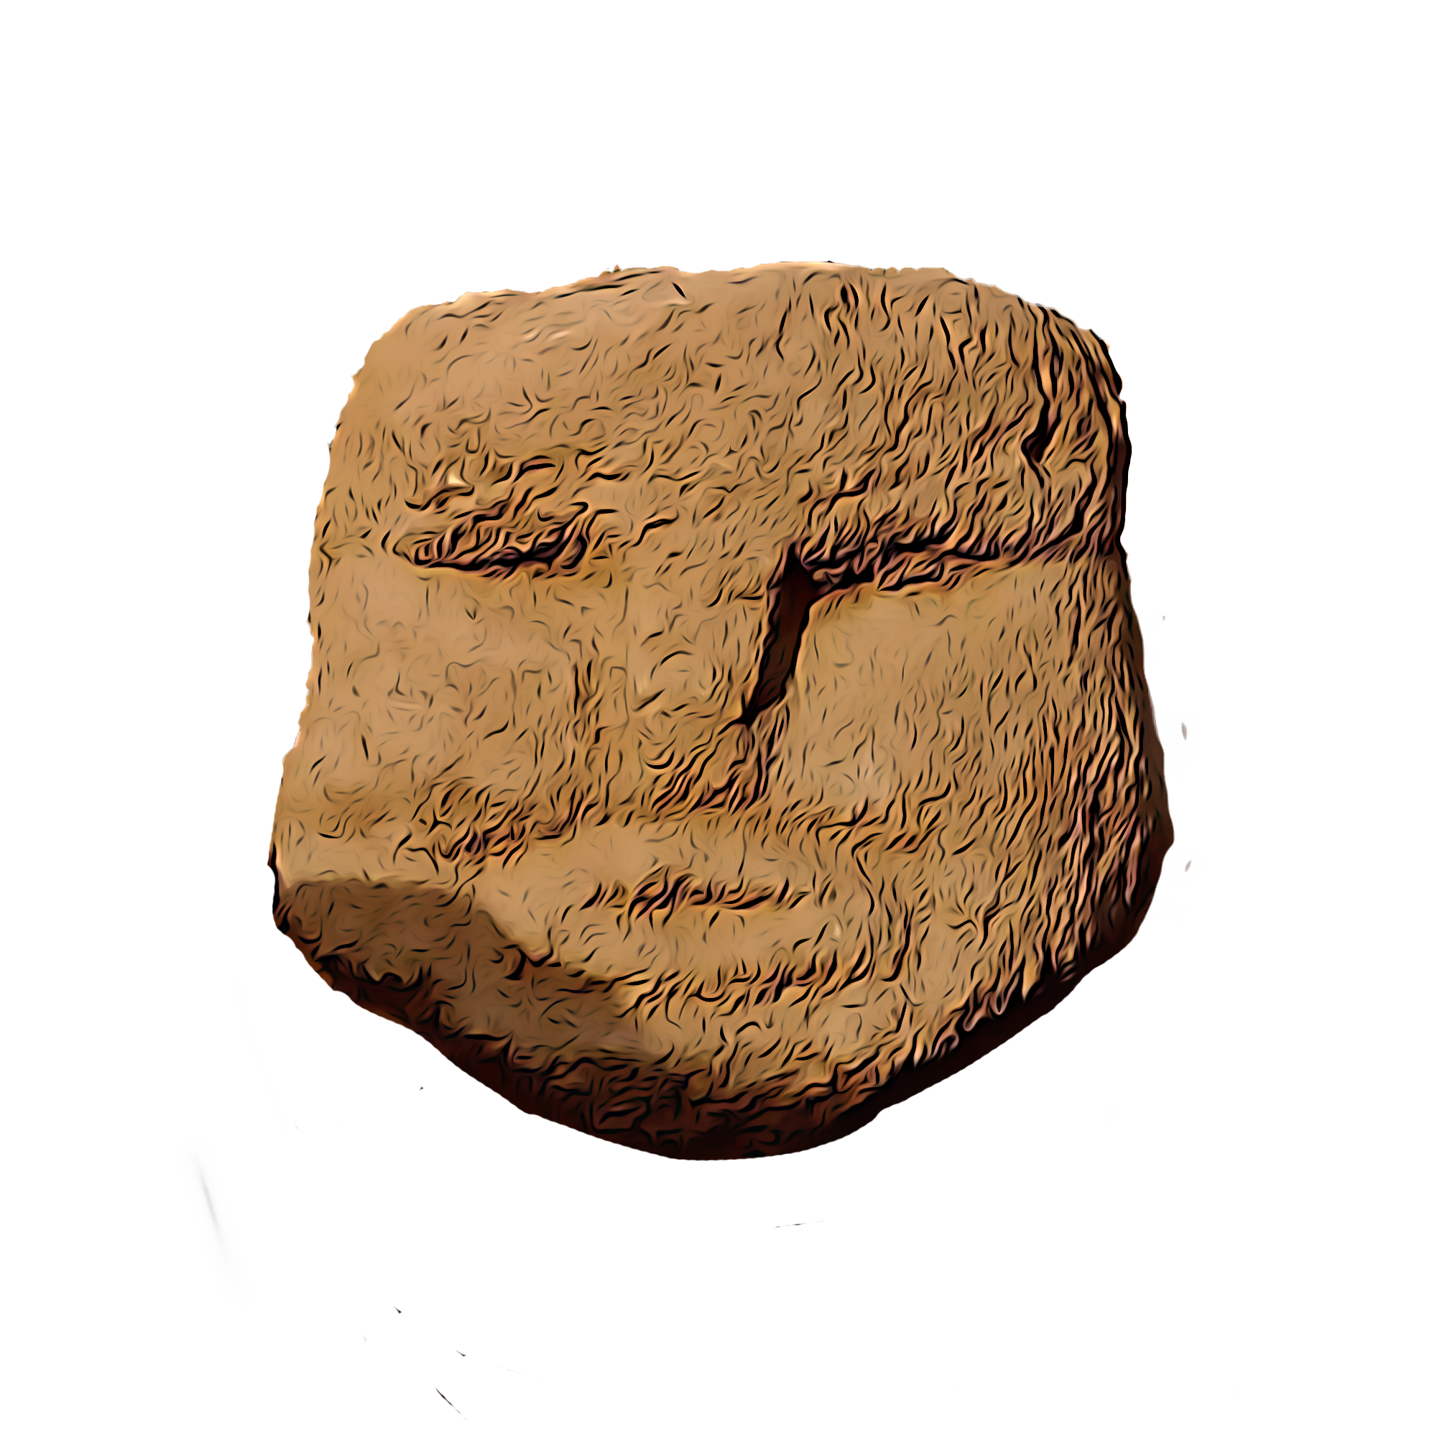
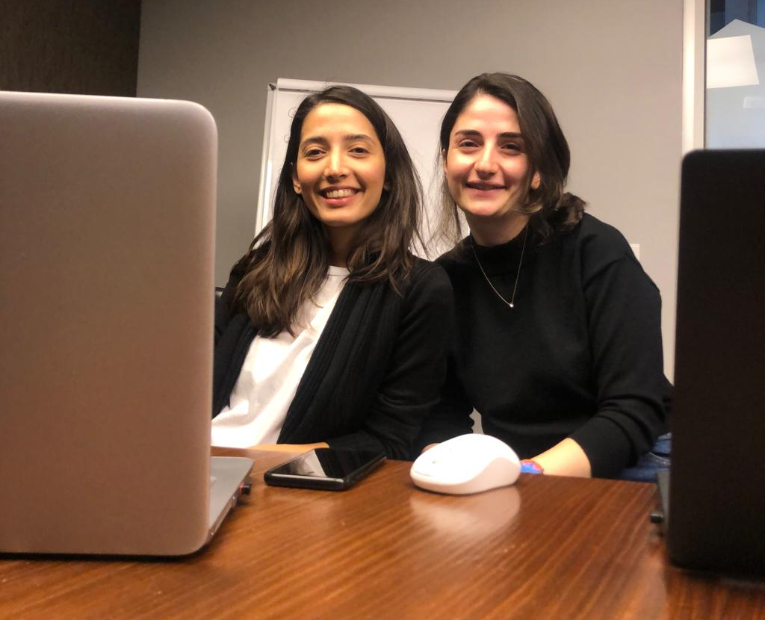
You see only your 70% of your friends in Social

Slide 2
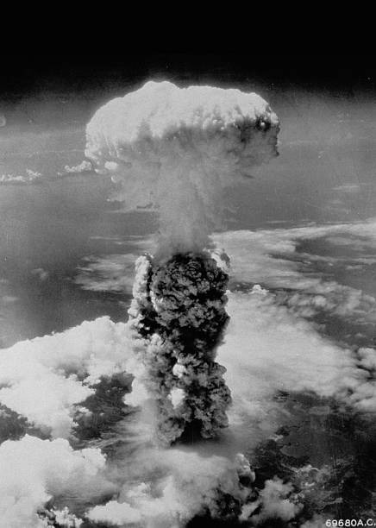
If you didn’t post it, did it even happen?

Slide 3
Times up. Catch the attention

Slide 4
Where our story begins

Slide 5
Make it simple. Make it fun

Slide 6
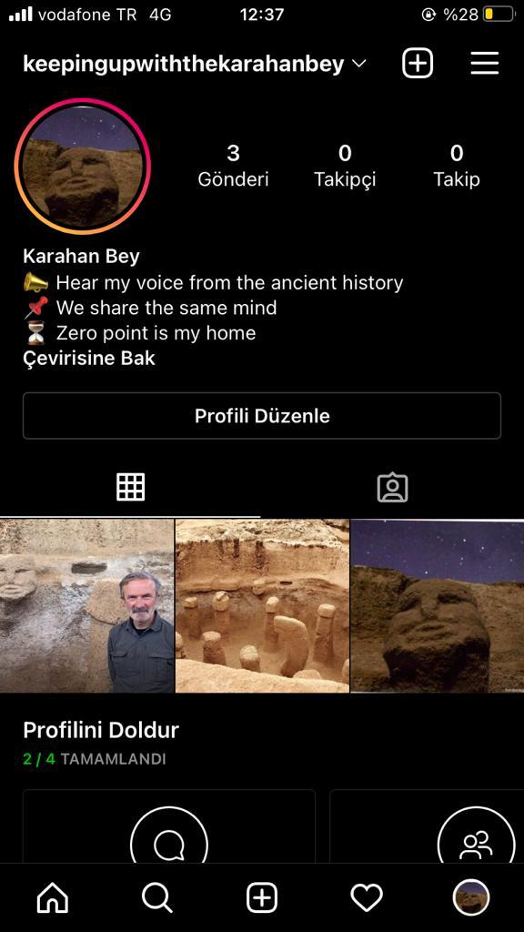
Creative Idea

Slide 7
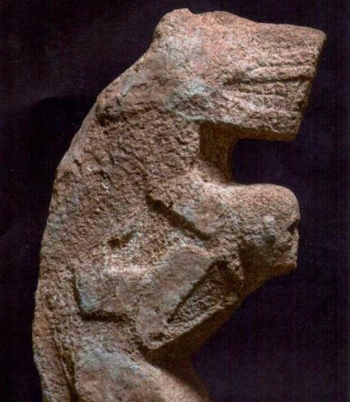
Ancient world = Modern world

Slide 8
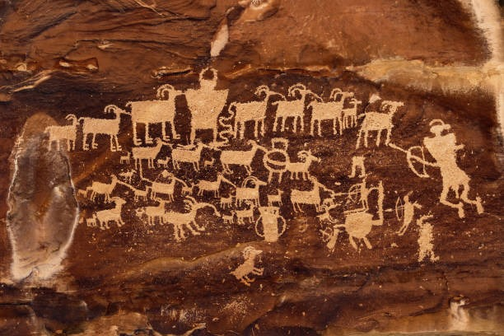
Ancient world X Modern world

Slide 9
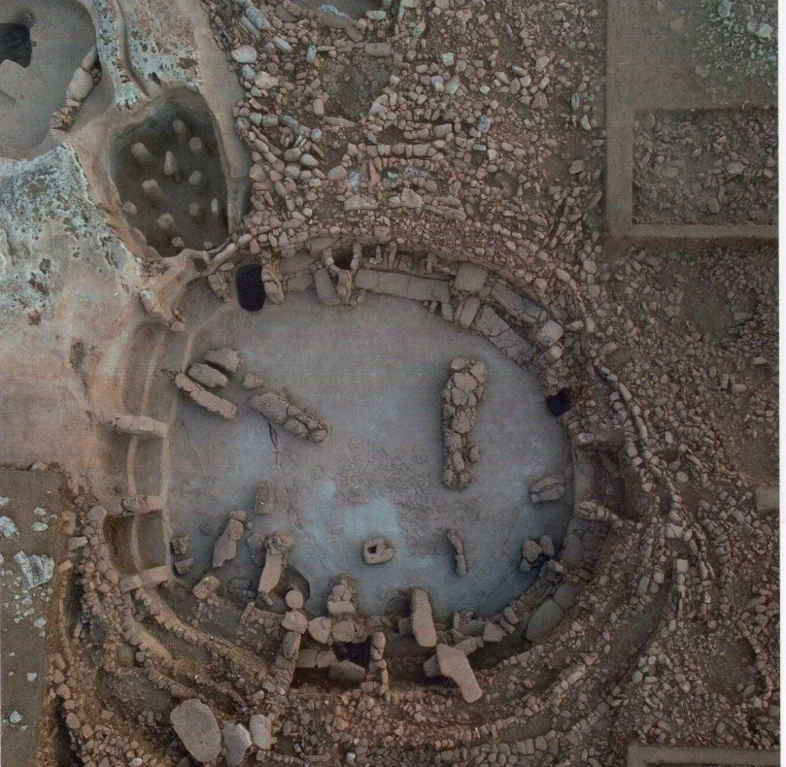
Let’s hit it and spread

Slide 10
Why This Idea Will Work?
Simple but effective
Accessable & Friendly
Opportunity create W-O-M

