Slide 1
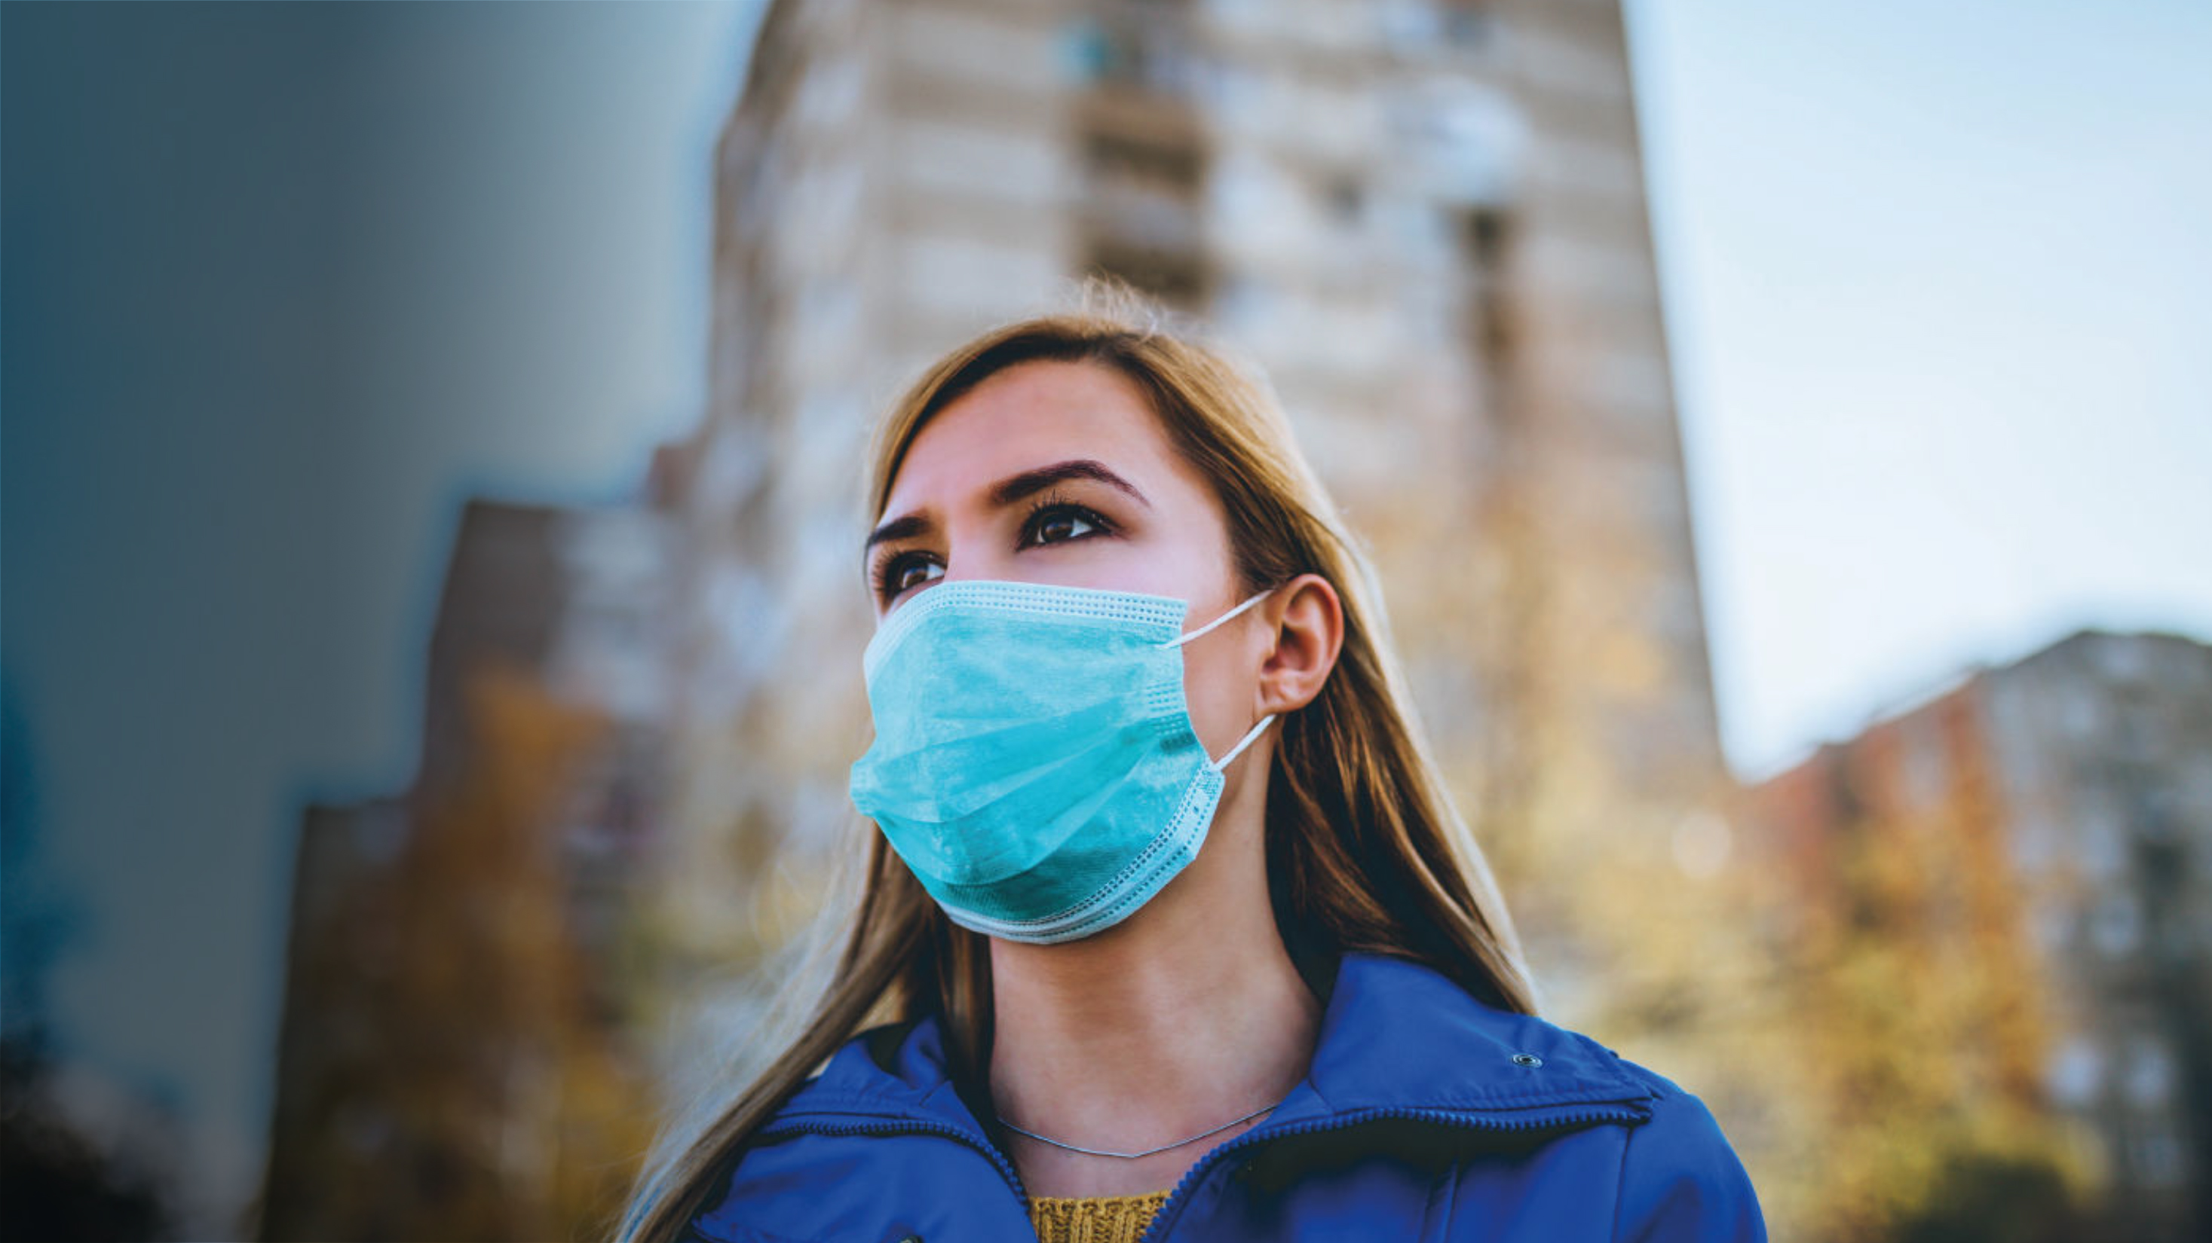
Covid-19 Barometer
March 2020
Rosie Hawkins, Kristanne Roberts, Amy Fridlund and Jane Ostler

Slide 2



Kantar’s C19 Barometer is the leading study on how Covid-19 is influencing consumers’ behaviours, attitudes and expectations
Across over 30 markets and over 25,000 consumers…
…and counting
2

Slide 3

First wave of research has been conducted between the 14th and 23rd of March, and covers:
Consumer attitudes
Level and nature of concern
Trusted sources of information
Areas of advice sought
Media habits:
Impact on media channel usage
Impact on social media usage
Impact on online/offline purchase behaviour:
Channel (online/offline, store format)
Price/promotion sensitivity
Stockpiling
Product origin
Willingness to use electronic payments
Categories affected by online purchase behaviour*
Attitudes to online purchase behaviour
Expectations from brands
Appropriate perspective on the situation
How they should communicate
Tangible actions to take
And more…

Slide 4
Setting the context

Slide 5
At the point of analysis there were 200,000+ cases, and over 8,500 deaths from Covid-19
To simplify we have used the following market groupings
 | Early Stage | Mid Stage | Late Stage
Description | 0-few cases identified, low deaths and limited to no social distancing measures | Community transmission is taking place, with deaths increasing and some social distancing measures in place | Significant number of cases and deaths, full lockdown in place to control the spread of the virus
Markets | Belgium, Germany, South Africa, Netherlands, UK, USA | Spain & France Israel, Nigeria, Poland, Republic of Ireland, Saudi Arabia, Slovakia, South Korea, Turkey, UAE, Brazil, Canada, Czech Republic | China & Italy

Slide 6
What we will take you through today…
2. Changing media consumption behaviours
3. What brands and companies can do
4. Changing purchase behaviours
1. Global attitudes
Understanding the general level of concern, and what drives this
How is Covid-19 impacting media consumption behaviours
What can you do in response to the changing reality
How is Covid-19 changing the way we shop

Slide 7
1.
Global Attitudes

Slide 8
Overall, consumers are concerned about the Coronavirus situation, but personal concern remains relatively low

Slide 9







People are making many changes to their lifestyle in response to the outbreak
Total G7
Canada
France
Germany
Italy
Japan
GB
USA
Washing hands more often/for longer | 77% | 88% | 83% | 75% | 87% | 56% | 78% | 80%
Avoiding non essential social contact | 68% | 82% | 76% | 71% | 86% | 43% | 68% | 69%
Avoiding visits to pubs, cafes and restaurants when possible | 66% | 78% | 70% | 71% | 83% | 38% | 66% | 70%
Self-isolating at home | 56% | 67% | 85% | 44% | 75% | 21% | 43% | 64%
Avoiding public transport when possible | 54% | 63% | 66% | 62% | 77% | 34% | 57% | 51%
Working from home/working from home more often | 29% | 35% | 33% | 27% | 41% | 12% | 28% | 32%
Base: All adults – G7 (7005), CA (1000), FR (1000), GE (1004), IT (1000), JP (1001), GB (1000), USA (1000)

Slide 10
Seven in ten say their household income has or will be affected by coronavirus
Thinking about your household income, that is the income of everyone in your household, which one of these statements comes closest to your current situation?
Total G7
Canada
France
Germany
Italy
Japan
GB
USA
Coronavirus has already impacted on my household income | 31% | 36% | 24% | 20% | 39% | 20% | 29% | 38%
Coronavirus has not yet impacted on my household income but I expect it to in the future | 39% | 40% | 41% | 38% | 43% | 45% | 41% | 36%
TOTAL – Already impacted / I expect it to impact | 70% | 76% | 65% | 58% | 82% | 65% | 70% | 74%
Coronavirus will have no impact on my household income | 23% | 19% | 29% | 35% | 14% | 26% | 26% | 20%
Don’t know | 7% | 5% | 6% | 7% | 4% | 9% | 4% | 7%
Base: All adults excluding single adult households –
G7 (6 447), CA (936), FR (902), GE (867), IT (980), JP (914), GB (926), USA (922)

Slide 11
Some markets are more optimistic than others, believing the economy will recover quickly once the situation dies down

Slide 12
2.
Changing media consumption behaviours

Slide 13
Unsurprisingly cinema is seeing the biggest losses as the virus progresses, whilst TV, online platforms, social networks and messaging apps see the biggest gains
Claimed Reduction
Claimed Increase

Slide 14
Unsurprisingly cinema is seeing the biggest losses as the virus progresses, whilst TV, online platforms, social networks and messaging apps see the biggest gains
Claimed Reduction
Claimed Increase

Slide 15
WhatsApp has seen the greatest gains, as people look to stay connected

Slide 16
We see gains in usage across all age groups, but the younger age groups are more likely to increase consumption across all platforms
Percentage claiming increased usage

Slide 17
The media is critical as the most trustworthy information source
Notes:
Varies by market. National media channels tend to be most trusted. Exceptions:
Government agency websites:
Equal in China (to national media)
Italy
Netherlands
Republic of Ireland
Saudi Arabia
Turkey
UAE
UK
International Advisory bodies:
South Africa
Doctor:
US (
Interestingly, our Citizen Impact study across the G7 shows a clear divide between the different news channels when it comes to citizen trust. While people place a lot of trust in TV news channels (TV news is stated to be the most trusted information source to provide reliable information about coronavirus in France (33%), Germany (31%), Italy (37%), Japan (46%) and Great Britain (28%)), newspapers and news sites are much less trusted.

Slide 18
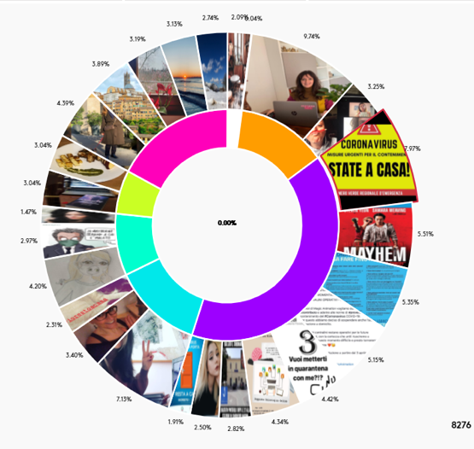
We identified six core themes from the images shared by people, representing their new needs and approaches
NO, SERIOUSLY
(40%)
Memes and selfies are normally frivolous and funny but it seems that in times of crisis they morph into something different.
LONGING FOR NATURE (17%)
As people stay inside it seems they are increasingly dreaming of outside (17%).
LAPTOP LIVES
(13%)
People are resourceful, and we see people quickly adapting, by switching their social and work lives into a digital format.
VISUAL CLUSTERS IDENTIFIED ON EVA
Themes identified:
NO, SERIOUSLY
LONGING FOR NATURE
SOFA AND SNUGGLES (13%)
Getting cosy and feeling safe with our pets and the people that we are close to.
CREATIVITY AND CRAFT (9%)
As the days grow longer
with little to do and nowhere to go people turn to their
own creativity to
keep entertained.
THE NEW ESSENTIALS (6%)
People love to share images of the things that are important to them. There are a whole host of ‘new essentials’ for self-isolation that people are sharing content around
LAPTOP LIVES
SOFA AND SNUGGLES
CREATIVITY AND CRAFT
THE NEW ESSENTIALS

Slide 19
5
What brands and companies can do

Slide 20
How should brands navigate the current global crisis?
The current global pandemic is a crisis beyond anything the world has experienced in recent times.
Few people have witnessed border closure, panic buying, mass business closure or enforced social distancing before
Brands in some categories face an existential threat – perversely, other brands may see opportunity.
What do your consumers need from you?
They need genuine responses and messages that make sense in this current world.
Brands, like their consumers, need to be responsible.
An opportunity to build trust by understanding the needs of those consumers and the role of the brand in this situation
So what can your brand credibly do in tune with the emotive positioning of the brand?
And no brand, however bold, will want to be remembered as having exploited the situation

Slide 21
Focus on staff welfare should be a company’s first priority. Companies and brands also have a role to play in supporting governments and consumers through the crisis

Slide 22
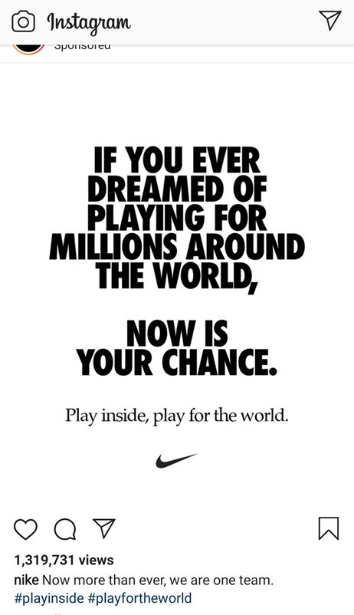
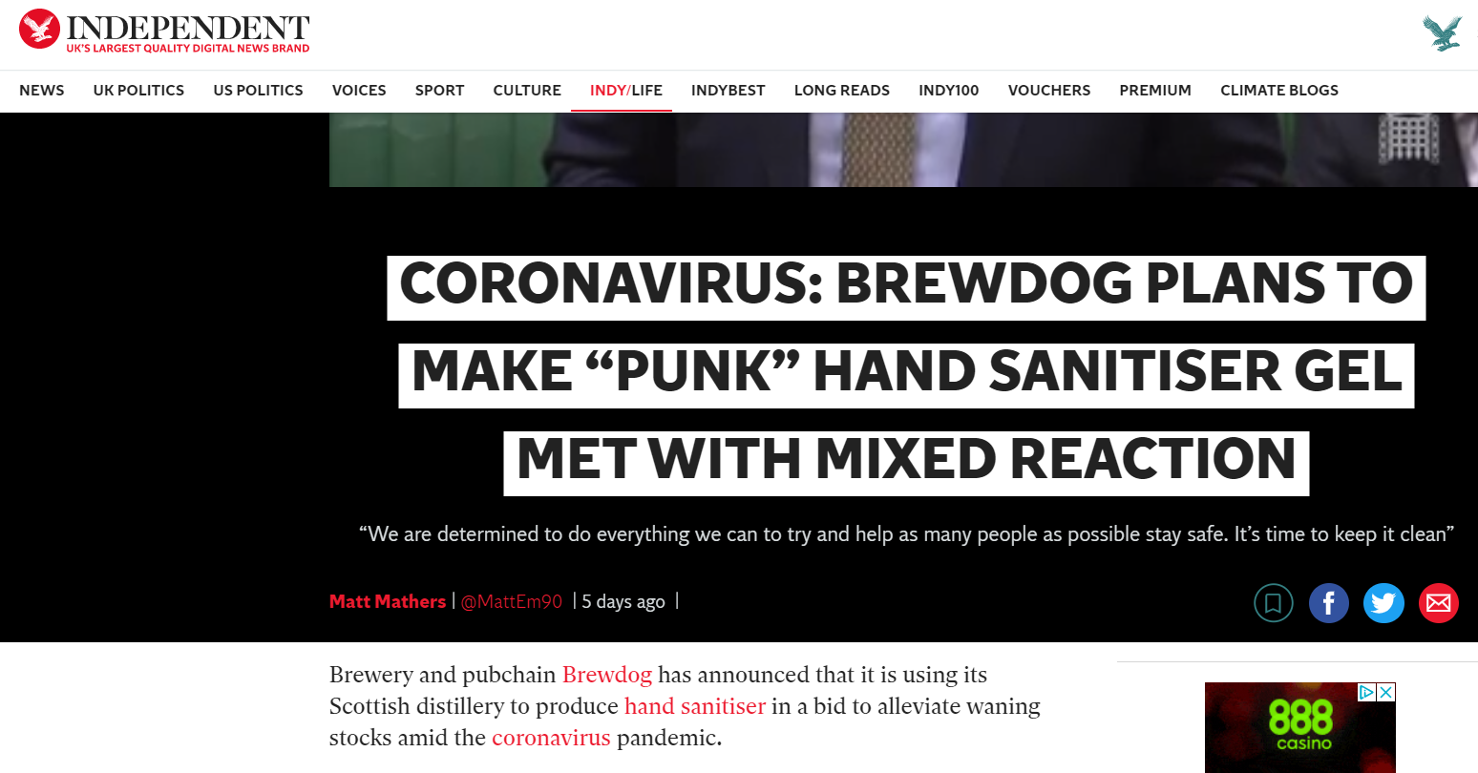
Whilst you might have your business practices right, you need to consider how consumers might perceive your actions
Do support local governments in health organisations…
But think about what the appropriate tone is for any communication

Slide 23
Do let consumers know how you can help, but think about your messaging carefully, as you don’t want to be seen to be exploiting the situation

Slide 24

A framework helps explain what we see happening around us
People are coping with a myriad of emotions from fear, anger, grief, resignation to hope and optimism.
A framework, based on psychology, helps navigate individual human responses to crises, explained by these dynamics.
Crises happen, it will pass
Low stress
We can get through this together
Collective responsibility
Individual responsibility
It is up to the individual to lead by example
High stress
Be prepared, don’t let the crisis take
you by surprise

Slide 25
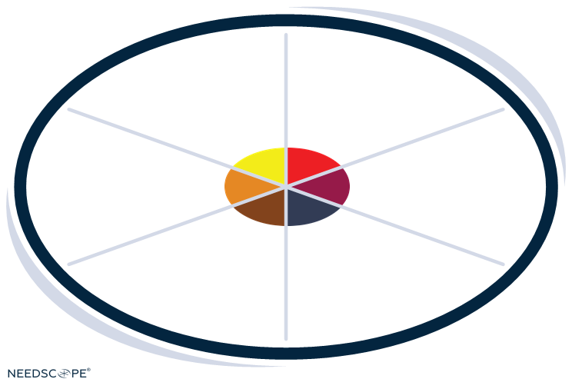
Human strategies in a time of crisis
People are not all the same… there is not a single generic response to a time like this.
We can also see how brands have responded to recent crises in each space.
These responses offer clues as to how brands can respond to the current crisis in ways that meet the emotional needs of their audiences.
Avert and deflect
Fight
and activate
Collaborate
and accept
Strengthen
and lead
Preserve
and defend
Strategise
and plan

Slide 26



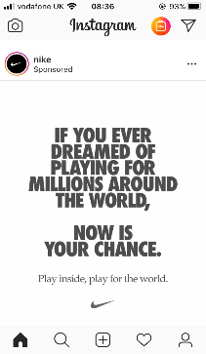
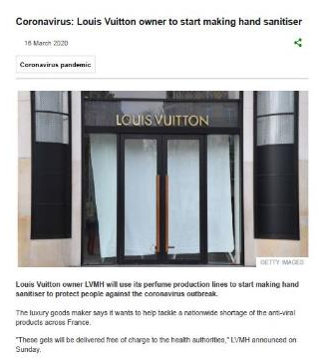
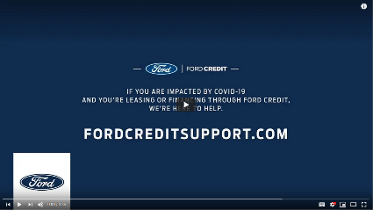
Some brands are taking the lead
Nike is sending out direct motivational messages: ‘play inside, play for the world’, encouraging people to use their apps to keep active and keep playing but for now play for the world.
Louis Vuitton took a leadership role and was amongst the first to turn its perfume production lines to hand sanitiser for health authorities. They have also stated they will honour this commitment as long as necessary.
Ford’s 'Built for Right Now’ messaging clearly reinforces that a brand which has been built over the decades for people who built the country, is now lending a hand to manage their credit.

Slide 27



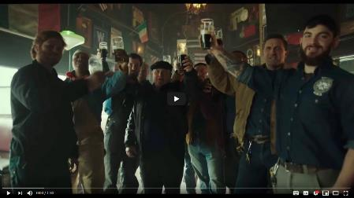
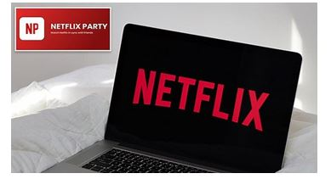
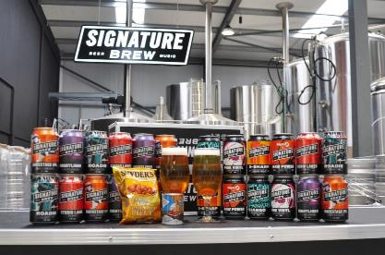
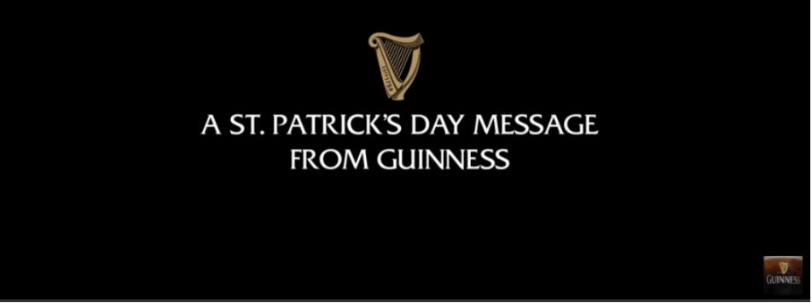

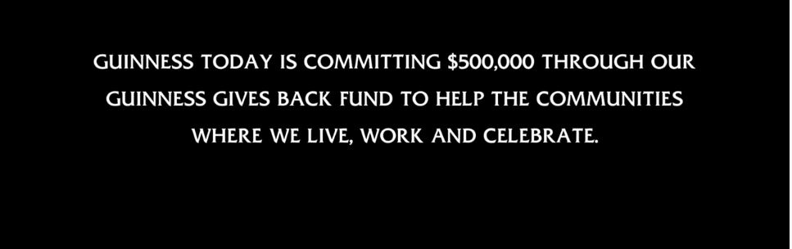

Other brands are connecting with communities
Guinness recognized that St Patrick’s Day would be different so sent feel good and supportive messaging to stick together and remember our communities.
Netflix is extending their party feature so friends can watch the same content in real time, while social distancing. It gives viewers a virtual experience of being part of something and connecting with others.
Signature Brew is supporting the local communities and talent to give a bit of light relief
to those who need it, creating a Pub in a Box.

Slide 28
What happens to brand health measures if you stop advertising on TV?
Net effects on brand measures 6 months after stopping TV advertising
TBCA
Total
Mentions
Buy
nowadays
Buy most often
First
mention
Key
image
Total brand awareness
Trial
-3
-5
-9
-8
Net change*
-13
-11
-21
-39
BASE: No of. brands
(632)
(836)
(376)
(501)
(627)
(232)
(840)
(744)

Slide 29
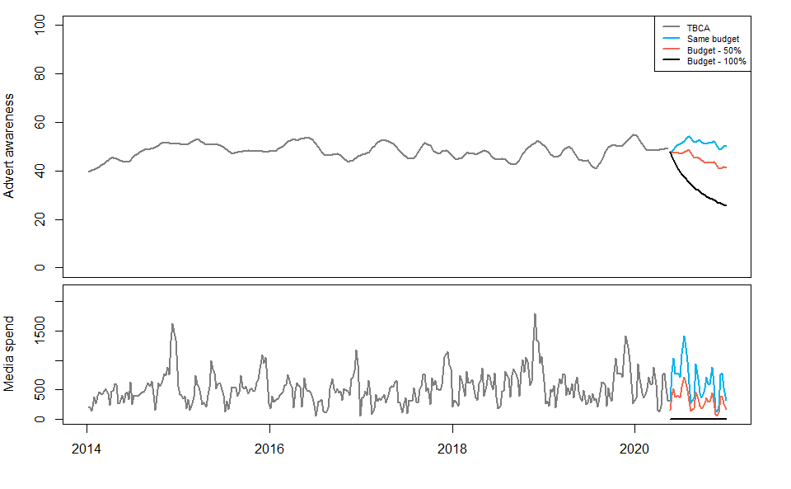
What happens if you decrease your adspend?
Simulation for a real beer brand to March 2021

Slide 30
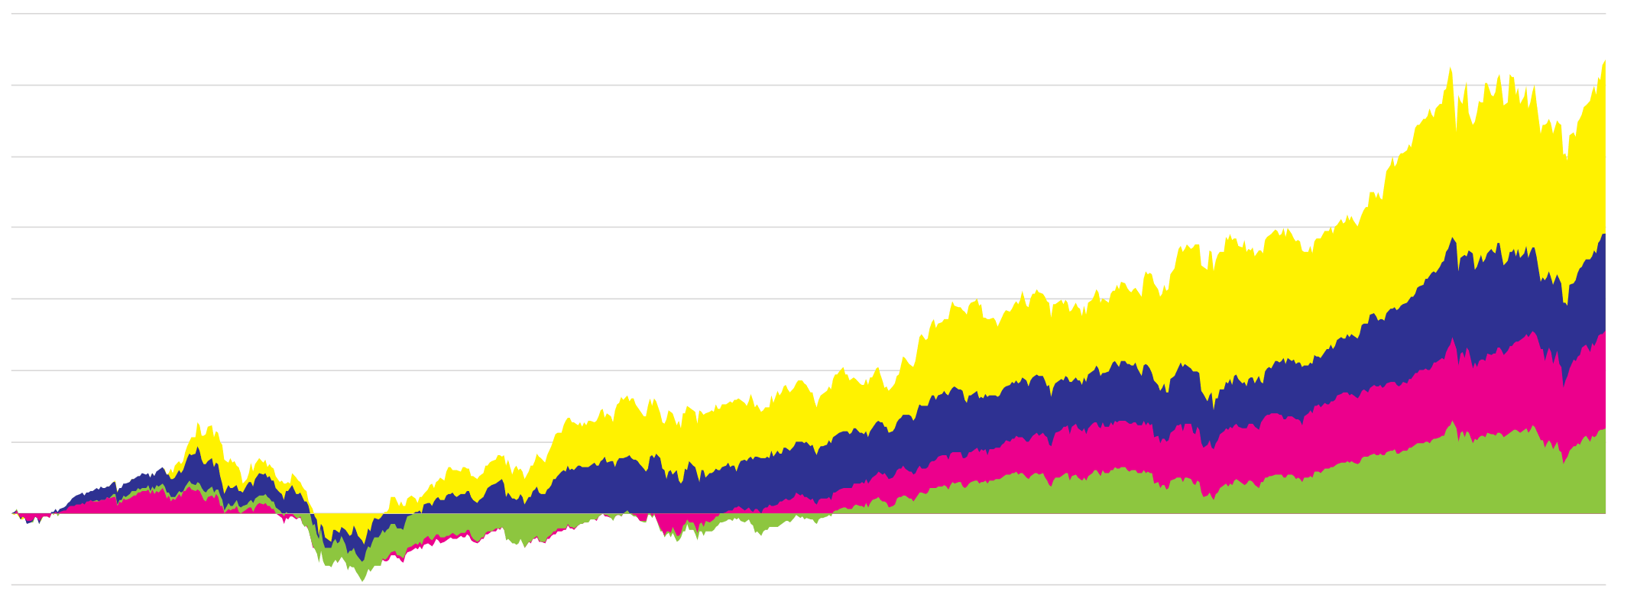

We’ve seen before that strong brands recovered NINE TIMES faster following the financial crisis of 2008
+317%
BrandZ Top 10
Powerful Brands
+196%
BrandZ Strong
Brands Portfolio
+128%
S&P 500
+59%
MSCI Word Index
2006
2007
2008
2009
2010
2011
2012
2013
2014
2015
2016
2017
2018
2019
Source: BrandZ Global, 2019
Notes:
Why do we need to build strong brand? In the past 14 years, the biggest lesson we’ve learned is that: Strong brands generate superior shareholder returns. Global Top100 outperforms S&P by a significant 53%, 3times higher than MSCI index. The most powerful top10, the brands enjoyed the highest customer endorsement and loyalty outgrown MSCI by 5 times. 0 based-budgeting has collapsed in 2018. Brand investment is a must-do for all the companies to ensure long-term sustainable financial growth, especially in the VUCA world.

Slide 31
3
Changing purchase behaviours

Slide 32
Physical stores remain critical for food & beverages and pharmaceutical
% Purchased 1st time in last month
11%
13%
10%
10%
9%
11%

Slide 33
Transacting in-store is down and intention to buy online is increasing
20%
9%
32%
Have shopped less in physical stores
Have shopped more on online
Expect to shop more online
Notes:
As governments impose lockdowns this figure increases, but the economic outlook is likely driving consumers to save. Combined with a reduction in availability of online purchases in travel, and work/social clothing purchases.

Slide 34
Retailers around the world are adapting
1. Redirecting resources
2. Implementing additional safety measures
3. Catering to different consumer groups
John Lewis & Partners (UK) has transferred 500 staff to Waitrose to help cope with the huge demand from shoppers stocking up on food and household staples.
Mercadona (Spain) restricting shopper access and imposing a one-meter rune as well as limiting cash payments
Lidl (Poland) has installed plexiglass shields to protect cashiers and will limit customer numbers in stores.
Morrisons (UK) will launch a call centre to enable orders to be taken over the phone for customers who do not shop online as well as introducing a new range of easy to order food parcels.
Iceland & Lidl (UK), Woolworths (Australia), Dollar General (US) are among the grocery stores to amend their opening hours to include a morning period exclusively for elderly and high-risk shoppers
Notes:
LVMH (France) is to convert perfume facilities to hand sanitizer production.
Burger King (US) is giving away children’s meals as schools shut down.
Globally, supermarkets are responding to increased demand by expanding their delivery service, and limiting numbers of items per shopper to curb stockpiling.
Morrisons (UK) will launch a call center to enable orders to be taken over the phone for customers who do not shop online as well as introducing a new range of easy to order food parcels.
Sainsbury’s (UK) is closing its cafes and meat, fish and pizza service to free up its staff for delivery demand.
Iceland & Lidl (UK), Woolworths (Australia), Dollar General (US) are among the grocery stores to amend their opening hours to include a morning period exclusively for elderly and high-risk shoppers.
Hema (Netherlands) has been able to get ahead of shifting demand using new software to recalculate a daily forecast.
John Lewis & Partners (UK) has transferred 500 staff to Waitrose to help cope with the huge demand from shoppers stocking up on food and household staples.
Mercadona (Spain) is restricting shopper access and imposing a one-meter rule, as well as limiting cash payments.
In Romania, the country’s largest shopping malls have reduced trading hours, excluding hypermarkets and drugstores.
Lidl (Poland) has installed plexiglass shields to protect cashiers and will limit customer numbers in stores.
Beauty brands, including Sephora and Ulta (US & Europe) close stores and shift online as coronavirus changes consumer habits.

Slide 35
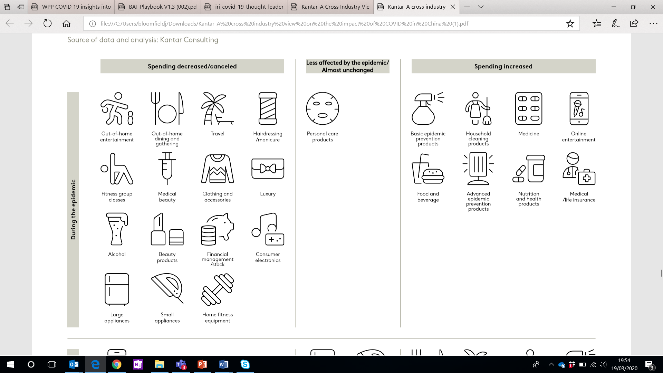
Learning from China, we know some sectors will be harder hit than others…
Notes:
In a survey carried out amongst Chinese consumers, we asked questions to probe into spending across 24 target sectors, as well as their willingness to resume or even increase consumption in such industries after the epidemic.
We have found that industries including tourism, catering and entertainment have been greatly affected due to a reduction in activities outdoors by - with 75% of consumers having completely stopped related consumption, and about 17% reduced their spending in the three sectors.
Industries with a less direct relationship to the pandemic have a lower degree of impact but still see significant changes, for example 57% of consumers reduced or stopped alcohol consumption due to lack of dining out together or visiting friends and relatives; within beauty (reduction + stoppage = 56%) and clothing (reduction + stoppage = 66%).
During this time, there are four key industries with different levels of stock shortages based on rapidly increased consumer spending; basic disease prevention (such as masks, hand sanitiser); advanced pandemic prevention (such as air purifiers); health food (such as vitamins); and medicine (such as cold medicine). Consumers will maintain a higher than average level of spending in them even after the pandemic ends. We have also found that consumers in the epicentre of the outbreak have significantly higher demands on health products than other areas in China.
Consumer spending in certain categories also increased during the epidemic; within food and beverages (increase in spending among 49% of respondents), household cleaning (increase in spending among 48% of respondents), medical insurance (increase in spending among 38% of respondents). Additionally, we see that the proportion of consumers purchasing medical insurance in Hubei province was significantly higher than that of other regions in China. There is still signs that there is a strong willingness for consumers to buy these categories after the pandemic.
Encouragingly, our data shows a more robust consumption rebound will occur in many industries after the pandemic ends.

Slide 36
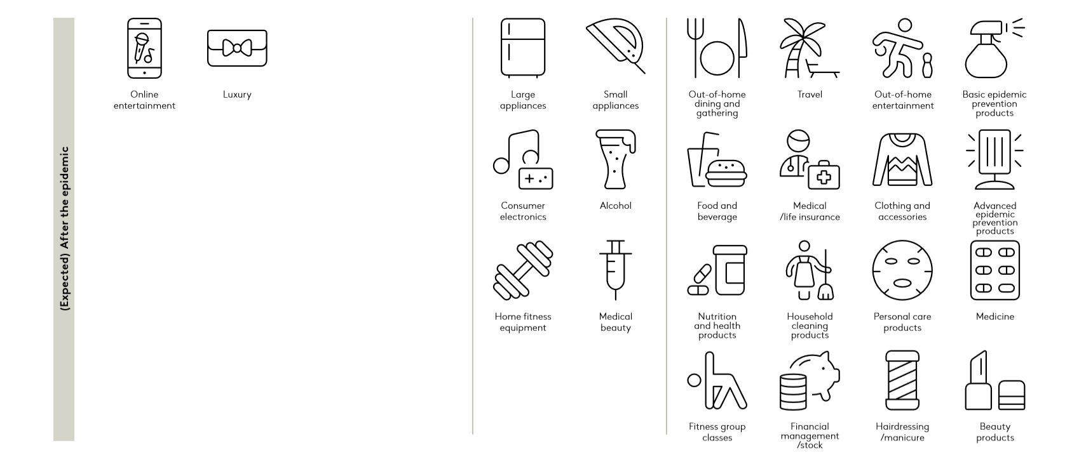
But after the pandemic, there is huge potential for rebound
Notes:
After the pandemic is over, there is huge potential for almost all categories and sectors to rebound, with 82% of the respondents claiming they would resume out-of-home dining and gatherings, 78% would resume travel, and 77% would resume out-of-home entertainment.
Our respondents in China said that they would also pay more attention to health-related consumption in the future. After the pandemic, 83% of the respondents would still buy masks and disinfectant for storage at home, 65% would turn wearing masks into a daily habit, 76% would pay attention to the sterilization and disinfection effects of personal care and household cleaning products, and 63% would buy related appliances for disinfection.
Generally speaking, consumption within the luxury sector is likely to be greatly affected greatly during the pandemic: 61% of respondents reduced or completely stopped their spending on luxury during the epidemic, and 21% of respondents would reduce their spending on luxury after the pandemic, which makes spending on luxury the most likely to be reduced. This may be related to deeper changes in consumption attitude of people.

Slide 37
3
Summary and commercial call to action

Slide 38
Learning from the data
Staff welfare should be a company’s first priority
Brands looking after their employees and offering flexible working are the top two concerns for consumers
There is still a place for advertising
Consumers still find this useful, and continuing to communicate will help your brand recover faster
As media behaviours change, there are new opportunities to reach people
Consider adapting your online and social media strategies as the pandemic progresses in each market
Consider your messaging and advertising strategy carefully
There’s a fine balance between being seen as helpful and profiteering, so ensure you are taking the right tone to build your brand

Slide 39
Questions?

